Slide 1



Test Automation
Samar Adel Mahmoud
Supervised by
Dr Amany Shousha
Eng Merna Hesham

Slide 2

Agenda
1- What is Test Automation
2- Why Use Test Automation
3- Manual Testing vs. Automated Testing
4- Test Automation life cycle
5- Requirement Analysis
6- Test Planning
7- Test Case Design & Development
8- Test Execution
9- Test results and reports
10- References
1

Slide 3
What is Test Automation?
Test automation is the process of using specialized software to execute tests on a Web application, compare actual results with expected outcomes, set up preconditions and preform other test related activities with minimal human intervention. It aims to enhance testing efficiency, increase test coverage, and accelerate the software development lifecycle.
2

Slide 4
Why Use Test Automation?
Faster Execution
Cumulative Coverage
Automated tests run instantly and repeatedly, enabling rapid feedback on code changes.
Automation enables continuous expansion of test coverage across builds, environments, and user scenarios.
Leverage
Repeatability
Reusable test components (e.g., utility classes, locators) allow teams to leverage existing work across projects.
Minimizes human error and ensures consistent validation across environments.
3

Slide 5
Manual Testing
Automated Testing
Human-executed
Flexible & intuitive
Time-consuming
Prone to human error
Good for exploratory testing
Best for usability & UI testing
Script-driven
Fast & repeatable
High initial setup time
Requires programming skills
Ideal for regression testing
Best for performance & load testing
4

Slide 6
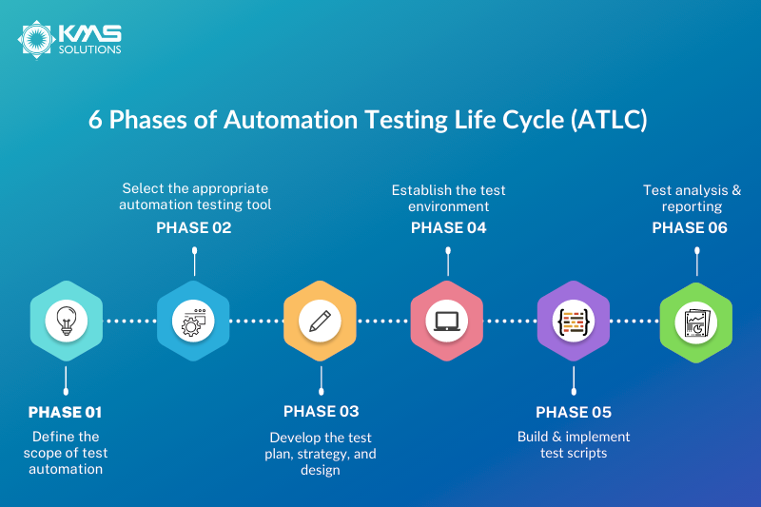
Test Automation life cycle
5

Slide 7








Automation Tools
Test Execution Tools
Selenium
Cypress
Playwright
Test execution frameworks (e.g., TestNG, JUnit)
Reporting Tools
Allure Reports
Extent Reports
CI/CD Tools
Jenkins
GitHub Actions
6

Slide 8
Requirement Analysis
7

Slide 9
Title:
Luma Website – Web Automation Testing Project
Website URL:
https://magento.softwaretestingboard.com
About:
Luma (Magento Software Testing Board) is a demo e-commerce site designed for practicing and validating automated test cases on the Magento platform.
Key Features:
Realistic Storefront: Includes product listings, cart, checkout, and user account flows for end-to-end testing.
Supports Automation Frameworks: Compatible with Cypress, Selenium, and Magento Functional Testing Framework (MFTF).
8

Slide 10
Project objectives
Identify key test scenarios for automation.
Cover end-to-end user journeys, not just isolated feature checks.
Ensure comprehensive coverage of functional behaviors, including both positive workflows and negative scenarios.
Define the scope and limitations of the automation project.
Select tools, frameworks, and execution environments.
Deliver a maintainable automation framework with clear reporting.
9

Slide 11
Requirements
Functional Requirements
Core E-Commerce Workflows
Product categories browsing, searching, and sorting
Product detail views
Add to cart, remove, and update items
Checkout process (guest users, registered users, and new user registration during checkout)
Payment flow (demo mode)
Wishlist management
User Account Features
User registration and login
Password recovery
14

Slide 12
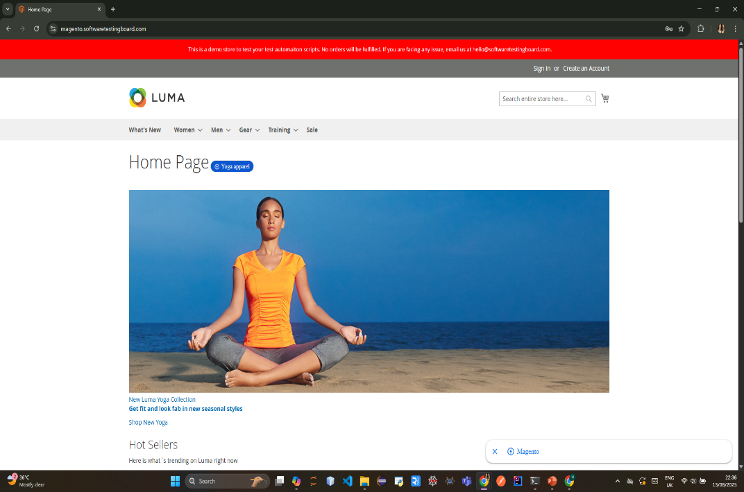
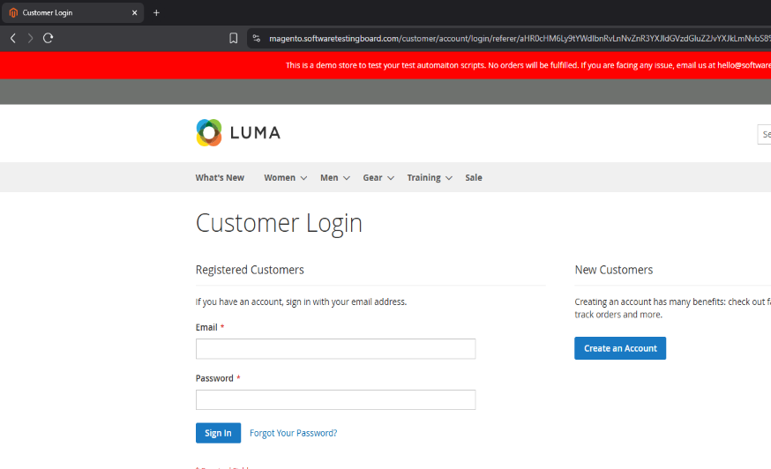
Project overview
Home page
login page
10

Slide 13
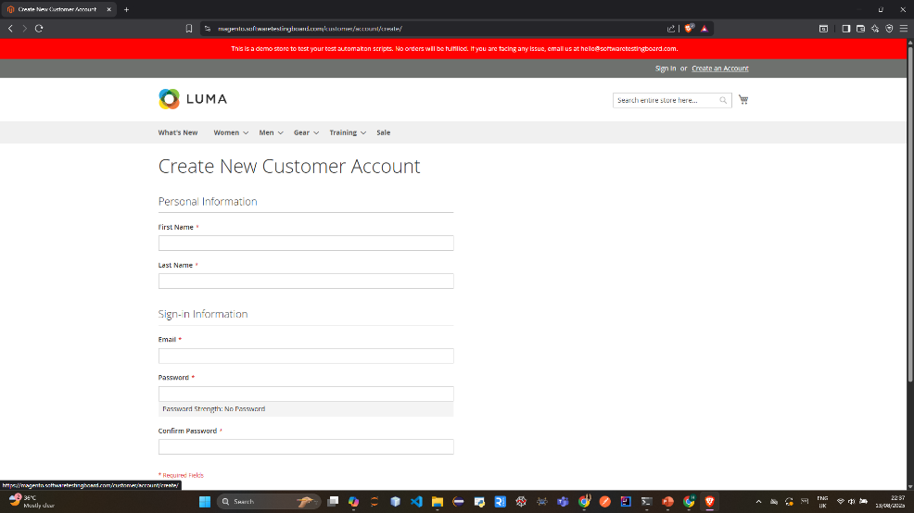
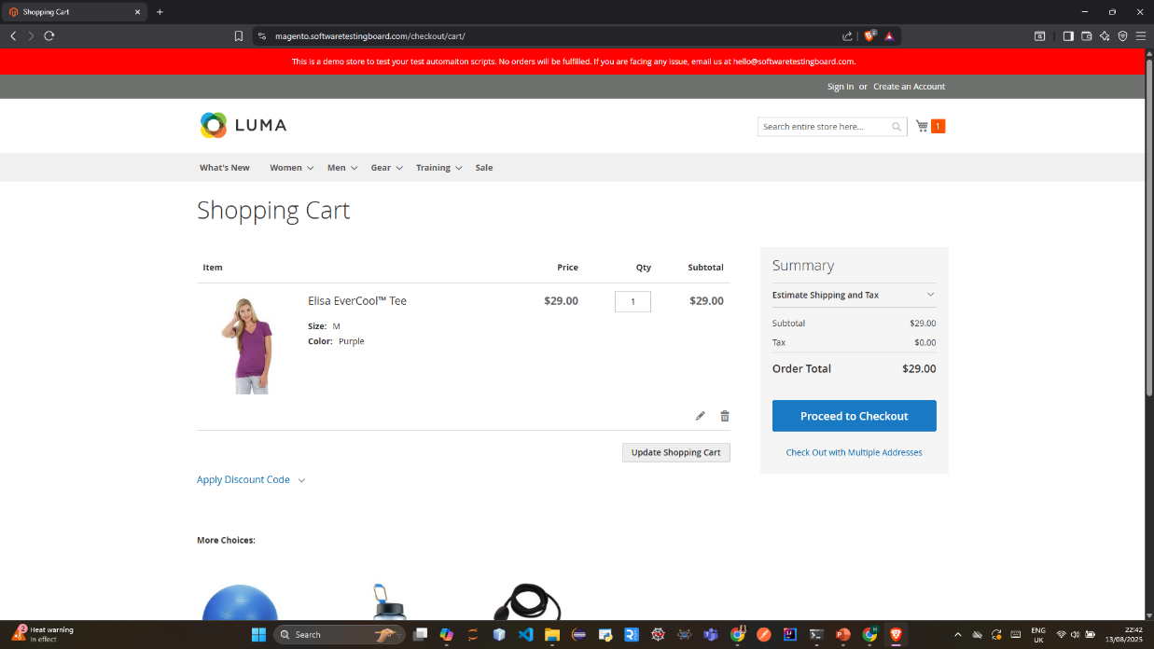
Create an account page
Cart page
11

Slide 14
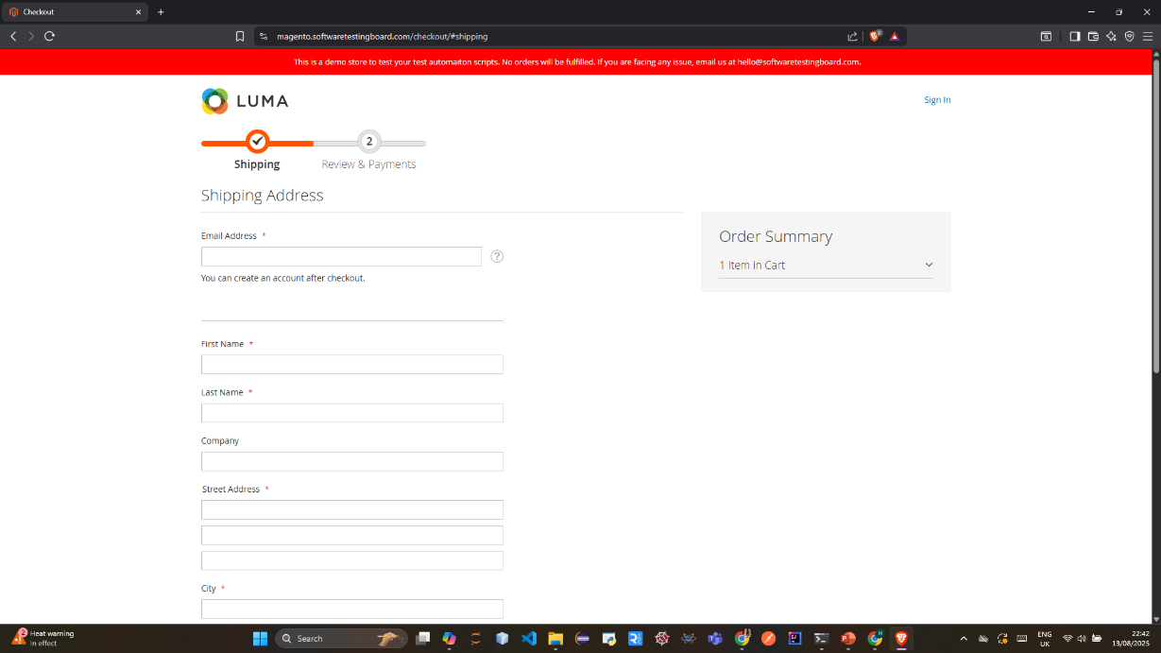
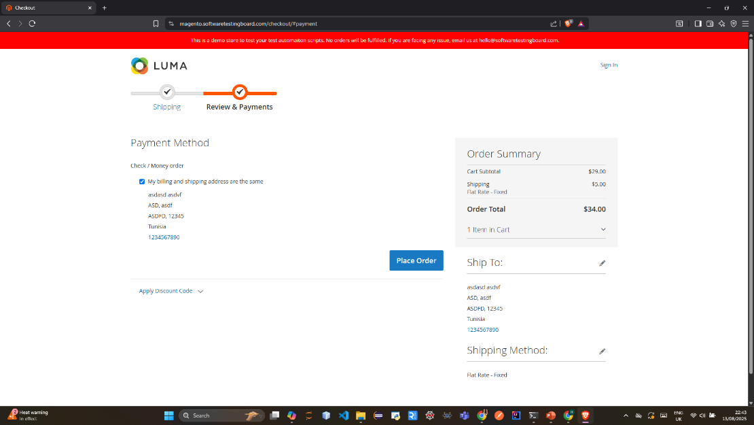
Shipping page
Payment page
12

Slide 15
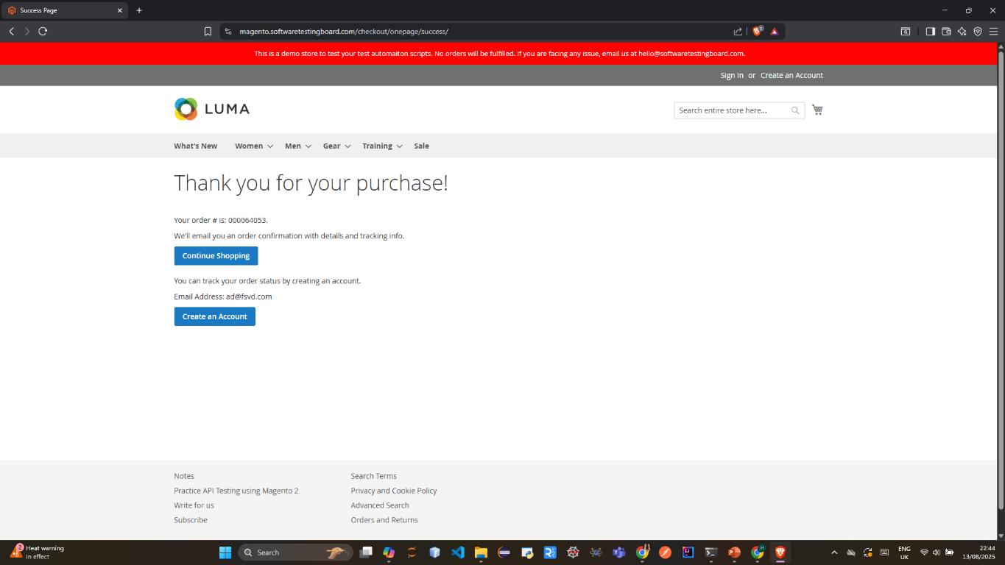
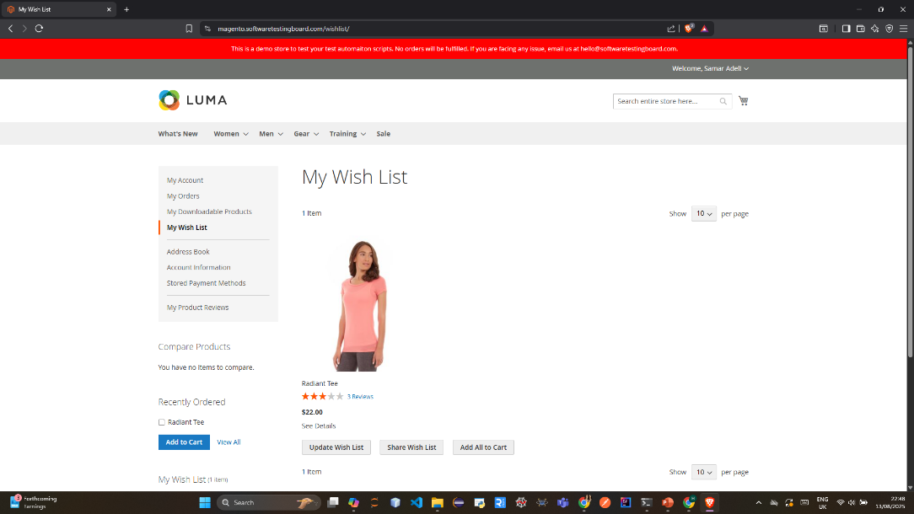
Order confirmation page
Wishlist page
13

Slide 16
Test Planning
15

Slide 17
Scope
Out of scope
Core Flows
Category navigation & Sorting
Product search & details
Add to cart
Wishlist
User account: signup/login
Checkout process
Cart discount & Coupons
Performance Testing
API Testing
Responsive Design: Mobile, tablet
Accessibility:keyboard navigation
Security
16

Slide 18
Tools & Frameworks
IDE: IntelliJ IDEA
Automation Framework: Selenium WebDriver + TestNG
Design Pattern: Page Object Model (POM)
Data-Driven Source: JSON test data
Browser: Brave (Chromium-based)
Reporting: Allure with screenshots on failure
CI/CD: Jenkins
17

Slide 19
Test Case Design & Development
18

Slide 20
I created test cases for every feature/page of the Luma demo site.
Designed 6 end-to-end scenarios for the Magento demo site:
3 positive (happy path)
3 negative (edge cases)
Each scenario spanned multiple features to reflect real user journeys ensuring full functional flow coverage.
19

Slide 21
Features
01
02
03
04
05
Sign in
Sign up
forget password
sign out
search & sort
06
07
08
09
10
Cart
Product
Wishlist
Shipping
Payment
20

Slide 22
Positive Scenarios
Guest
Registed User
New User
Navigate to the Home Page
Select an item and add it to the cart
Proceed to checkout
Provide shipping details
Add payment method
Complete the purchase
Navigate to the Sign in Page
Sign in using valid credentials
Search for a product using the search bar
Sort search results by price (ascending)
Select size and color from product details page and add it to the cart
Add an item to the Wishlist
Open the cart and remove product
Navigate back to home and add an item to cart
Apply a discount code
Checkout (confirm address and payment)
Confirm order
Sign out
Navigate to sign up page
Create an account with valid credentials
Navigate to ‘Tee’ category
add a product to the cart
update product quantity
set quantity to 4 to apply cart discount
Checkout (add shipping address and payment)
confirm order
21

Slide 23
Negative Scenarios
Forget Password
Invalid Product Selection
Invalid register
login with invalid credentials
leaving login fields empty
reset password with an email that is not registered
reset password with registered email
leaving fields empty
invalid format for email
registering with
existing email
fail to confirm password
check if user Enters Weak Password(format and length)
adding an item with quantity 0
out of stock item
adding item to wish list as a guest
adding an item without choosing size and color
22

Slide 24
Test Execution
23

Slide 25
Test results & reporting
Allure report
26

Slide 26
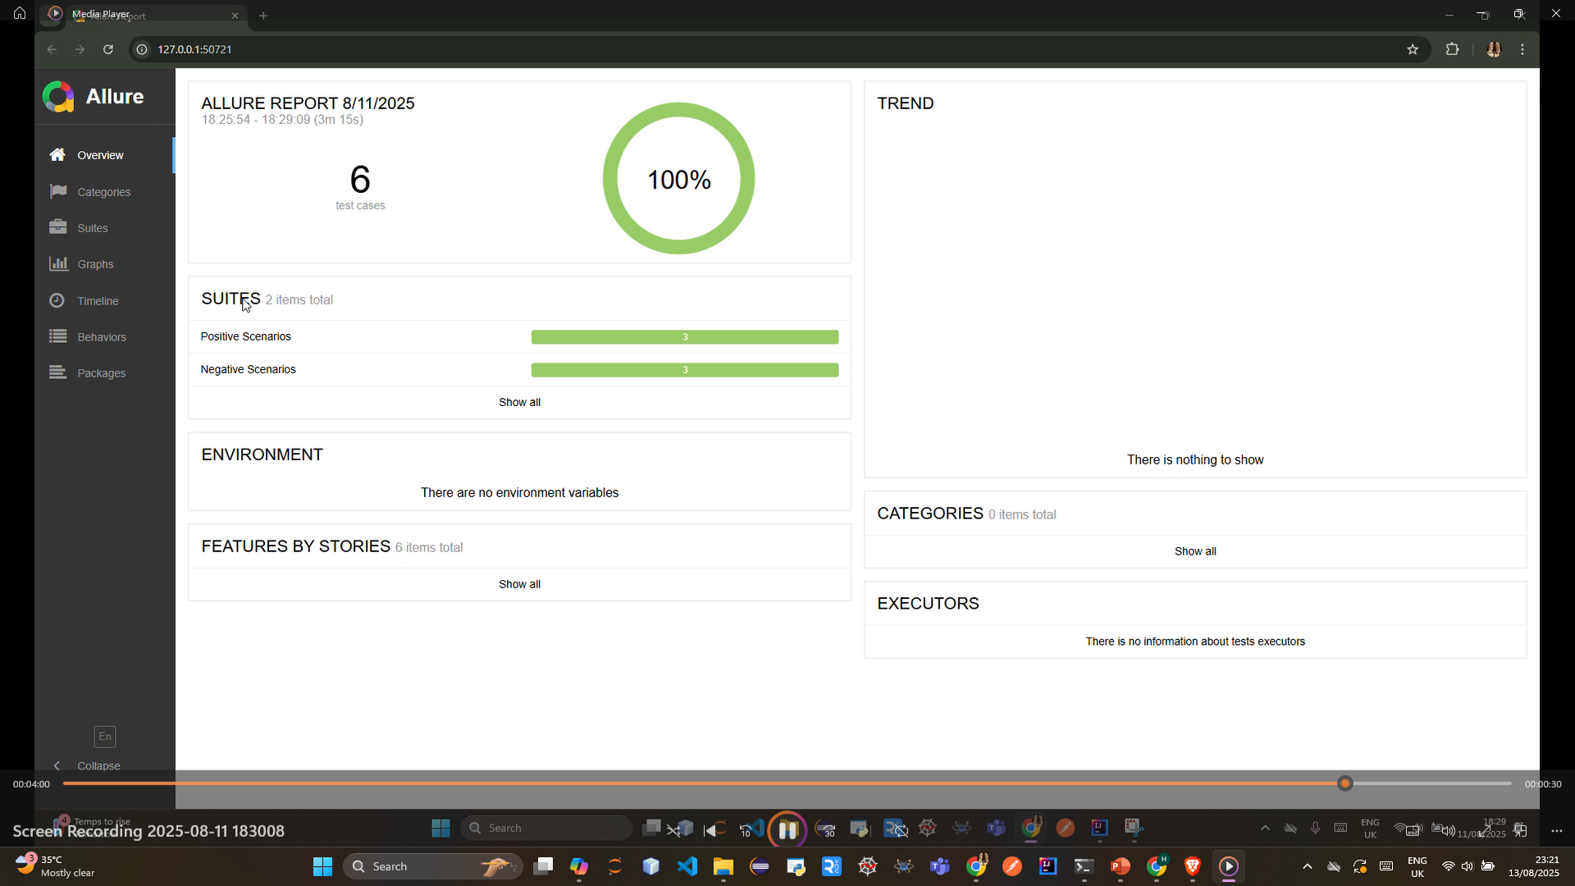
Scenarios report
27

Slide 27
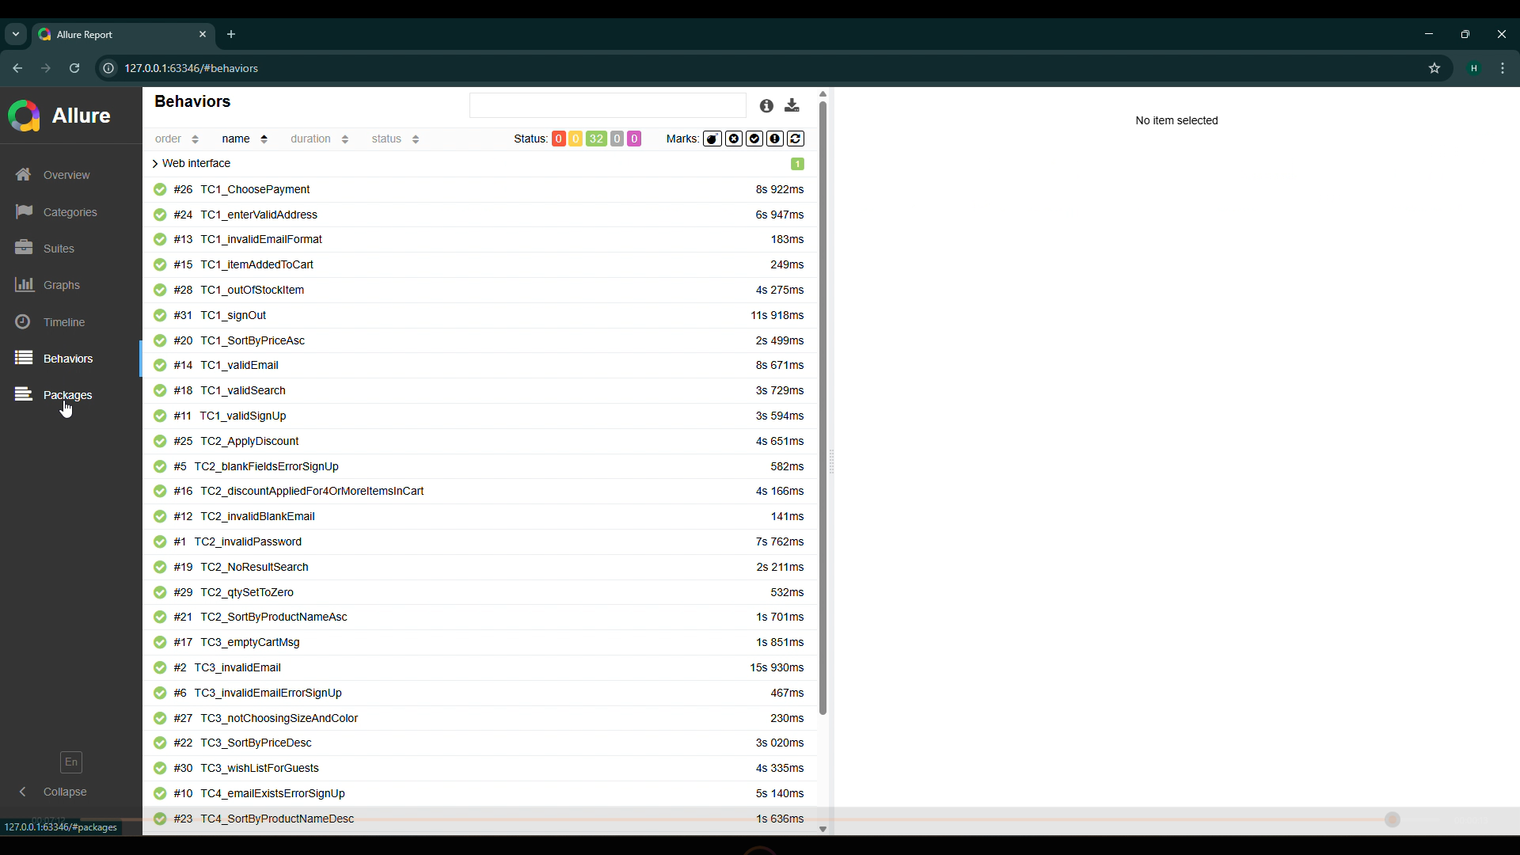
28

Slide 28
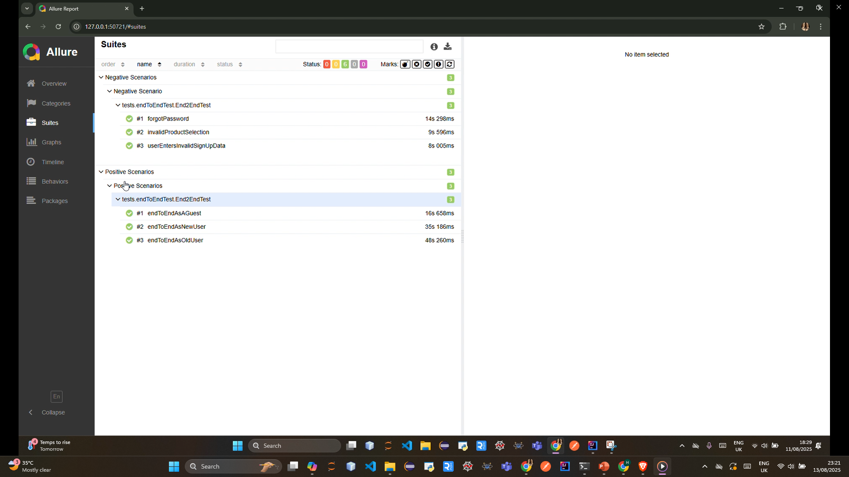
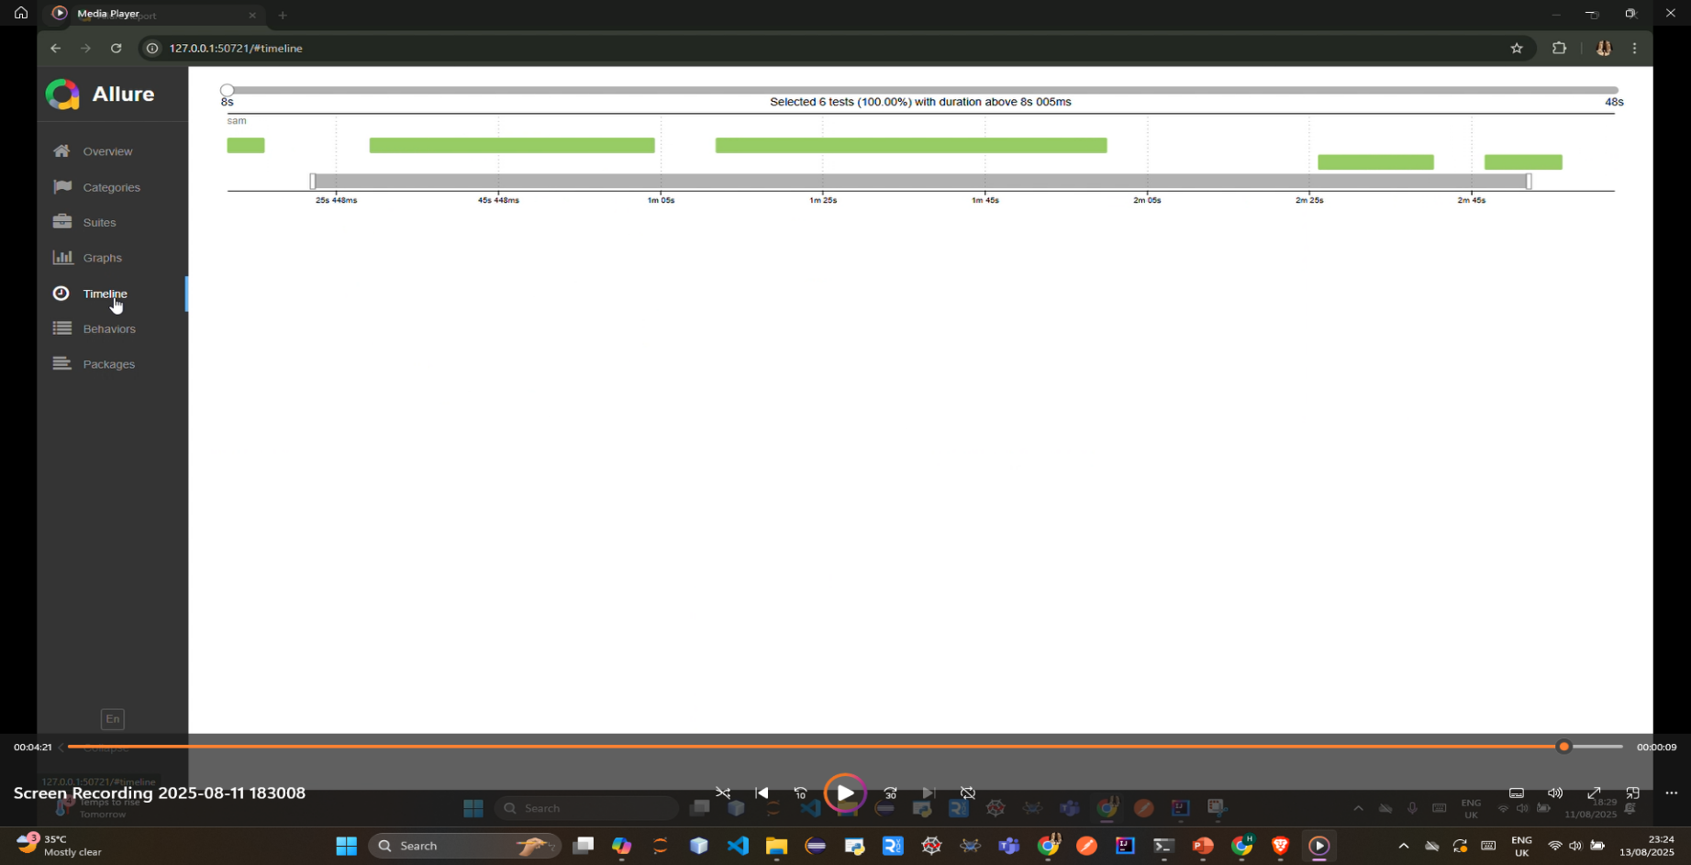
29

Slide 29
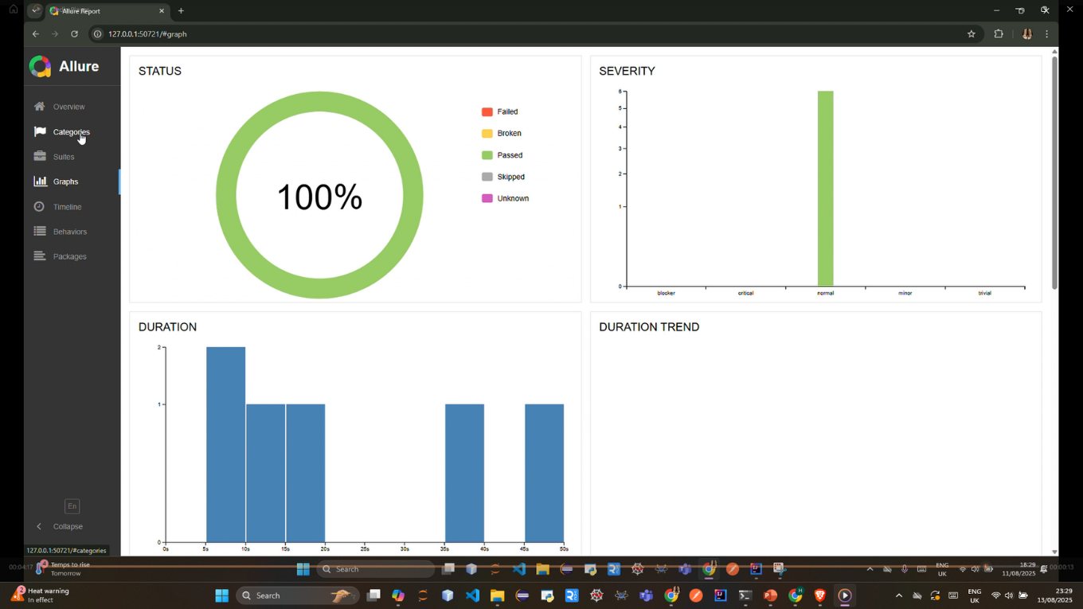
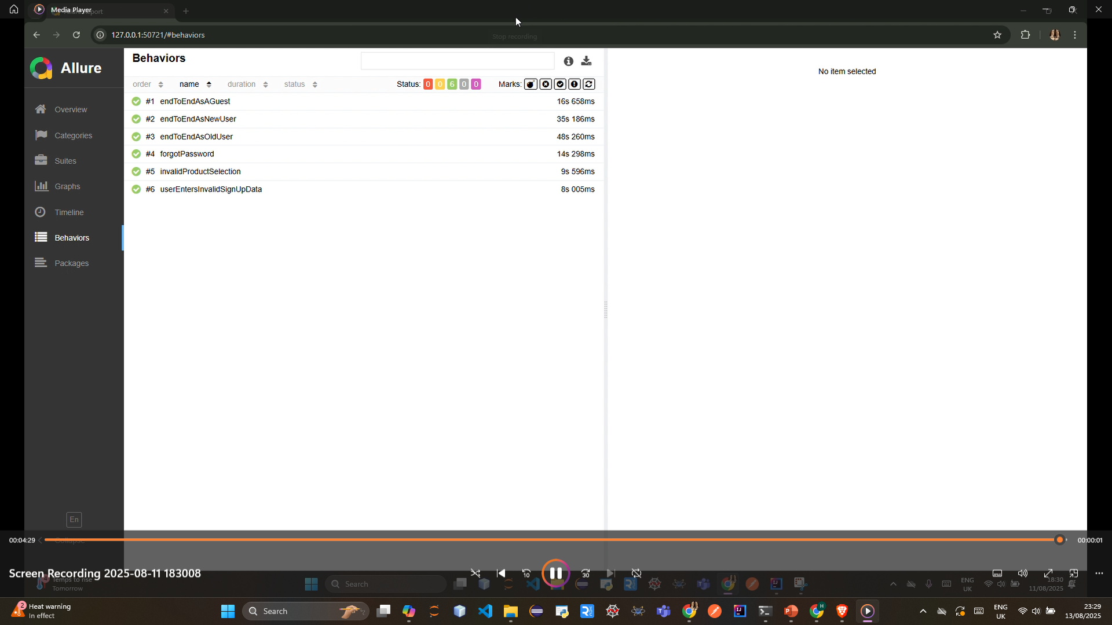
30

Slide 30
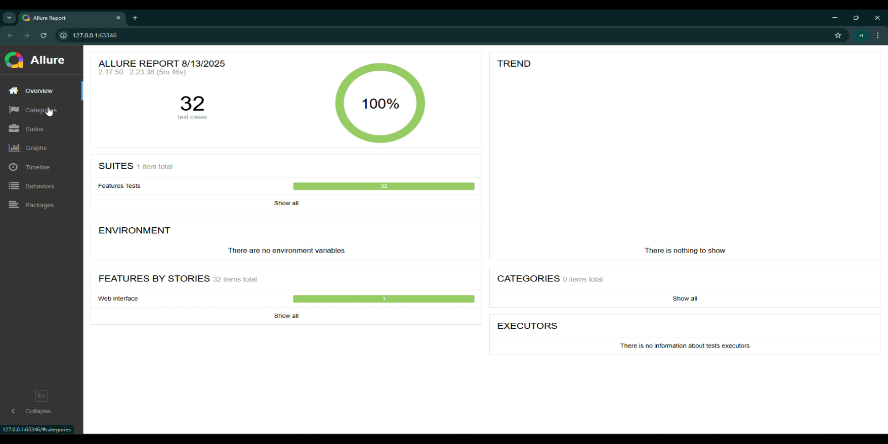
Features report
31

Slide 31
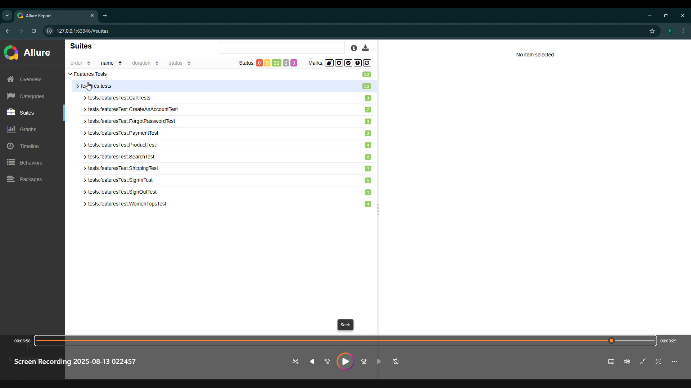
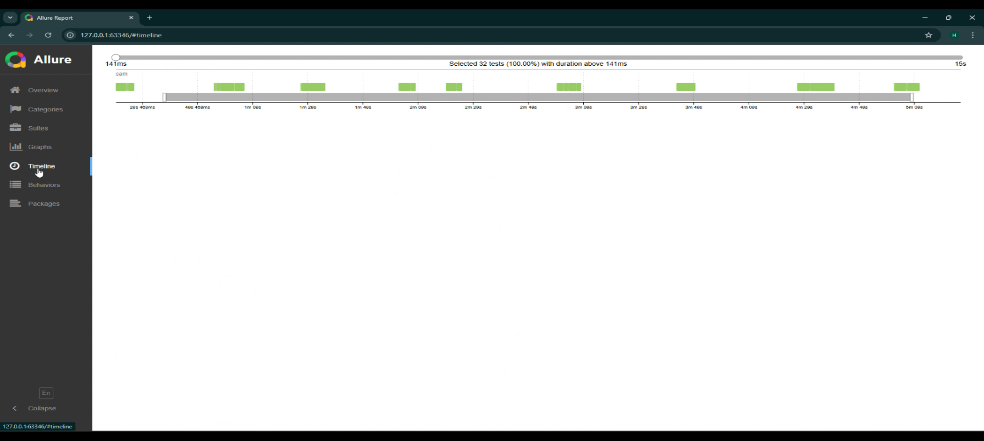
32

Slide 32
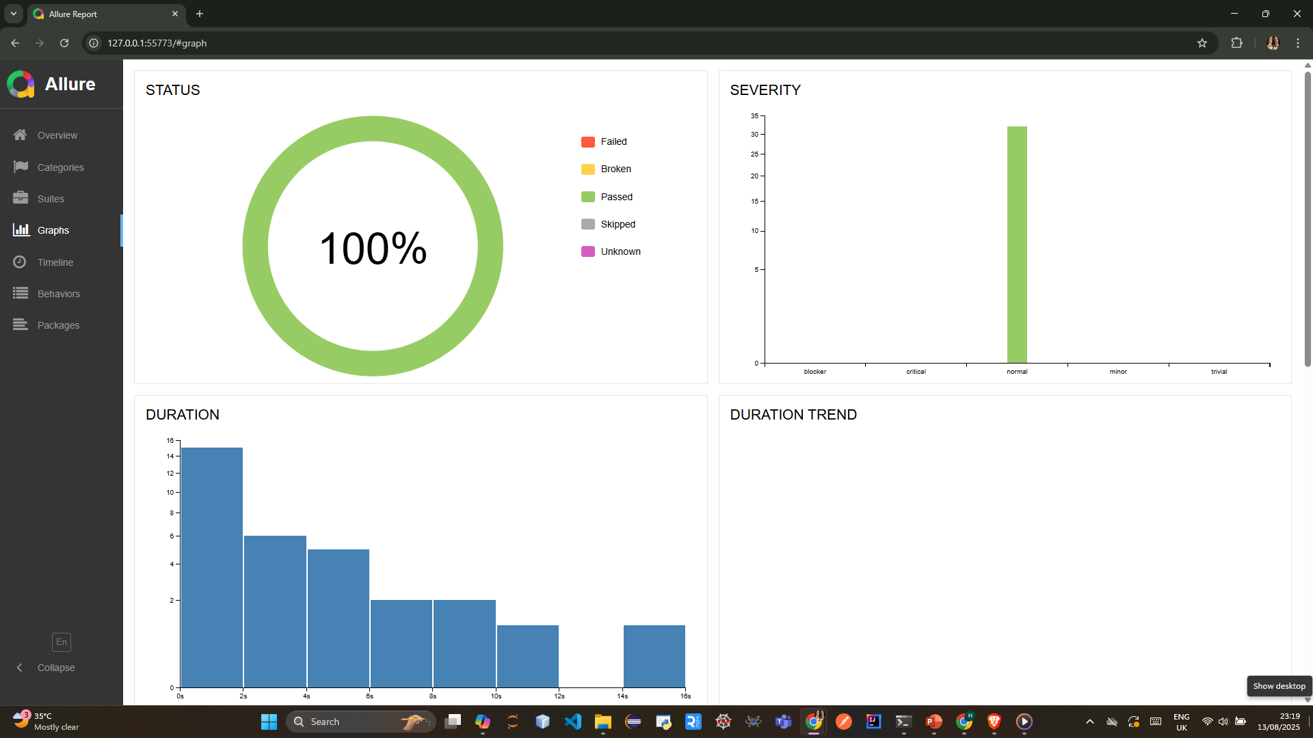
33

Slide 33
References
https://www.softwaretestpro.com/wp-content/uploads/2016/10/AutomatedTestingHandbook.pdf
https://istqb.org/wp-content/uploads/2024/11/ISTQB_CTAL-TAE_Syllabus_v2.0.pdf
https://www.geeksforgeeks.org/software-testing/automation-testing-software-testing/
https://kms-solutions.asia/blogs/level-up-your-testing-game-with-automation-testing-life-cycle
https://magento.softwaretestingboard.com/
https://www.udemy.com/?srsltid=AfmBOorbev76L1ZyS03qLAjVSuWUdwlpYtJKbID0f0-HIlhgu5uHxC7d
34

Slide 34
Thank you

